Slide 1
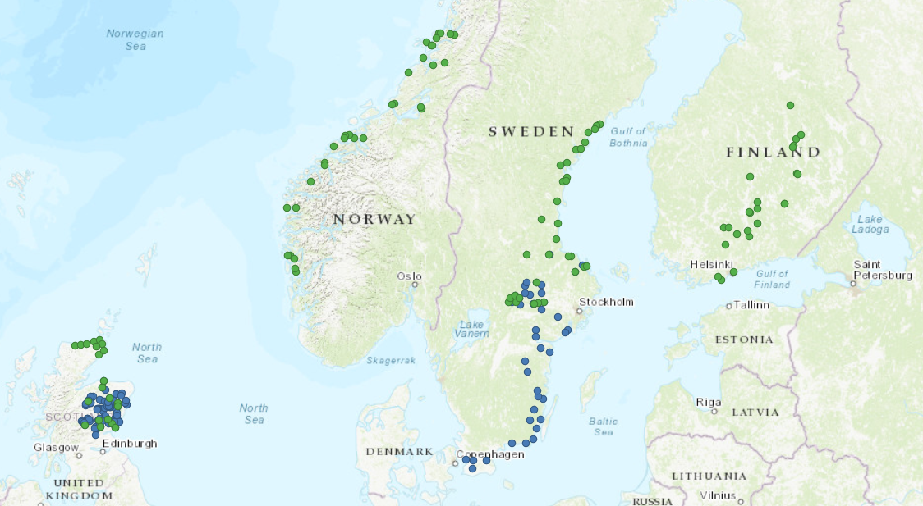
2022
2023
2022
2022
2022
2023
2014
2013
2013

Slide 2
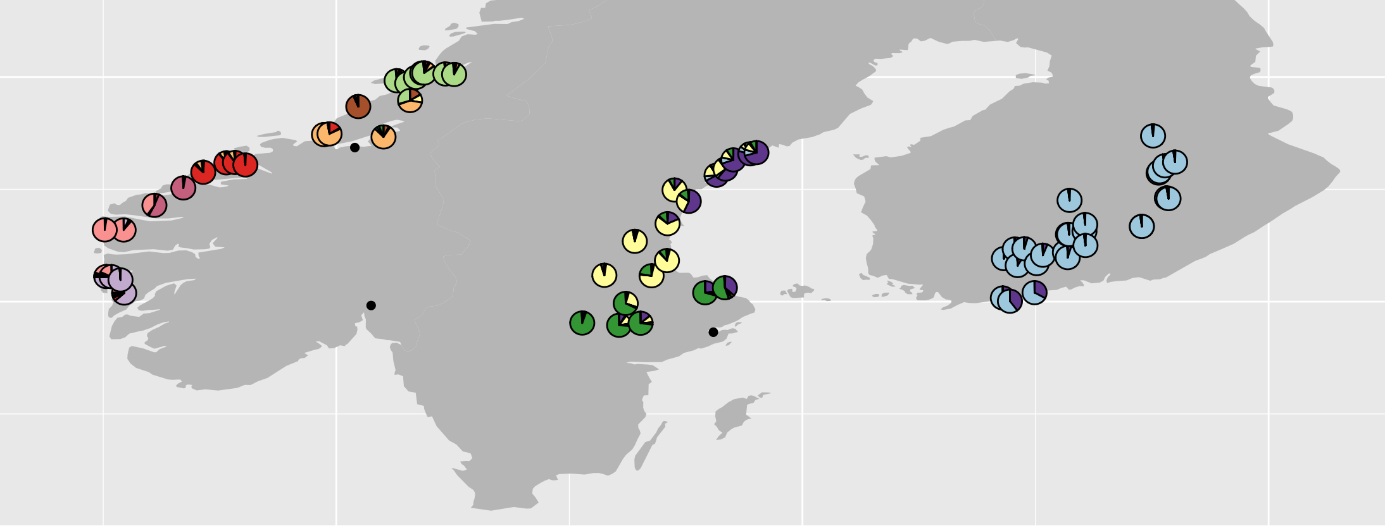
Whole Genome Sequencing data (2022 and 2023)

Slide 3
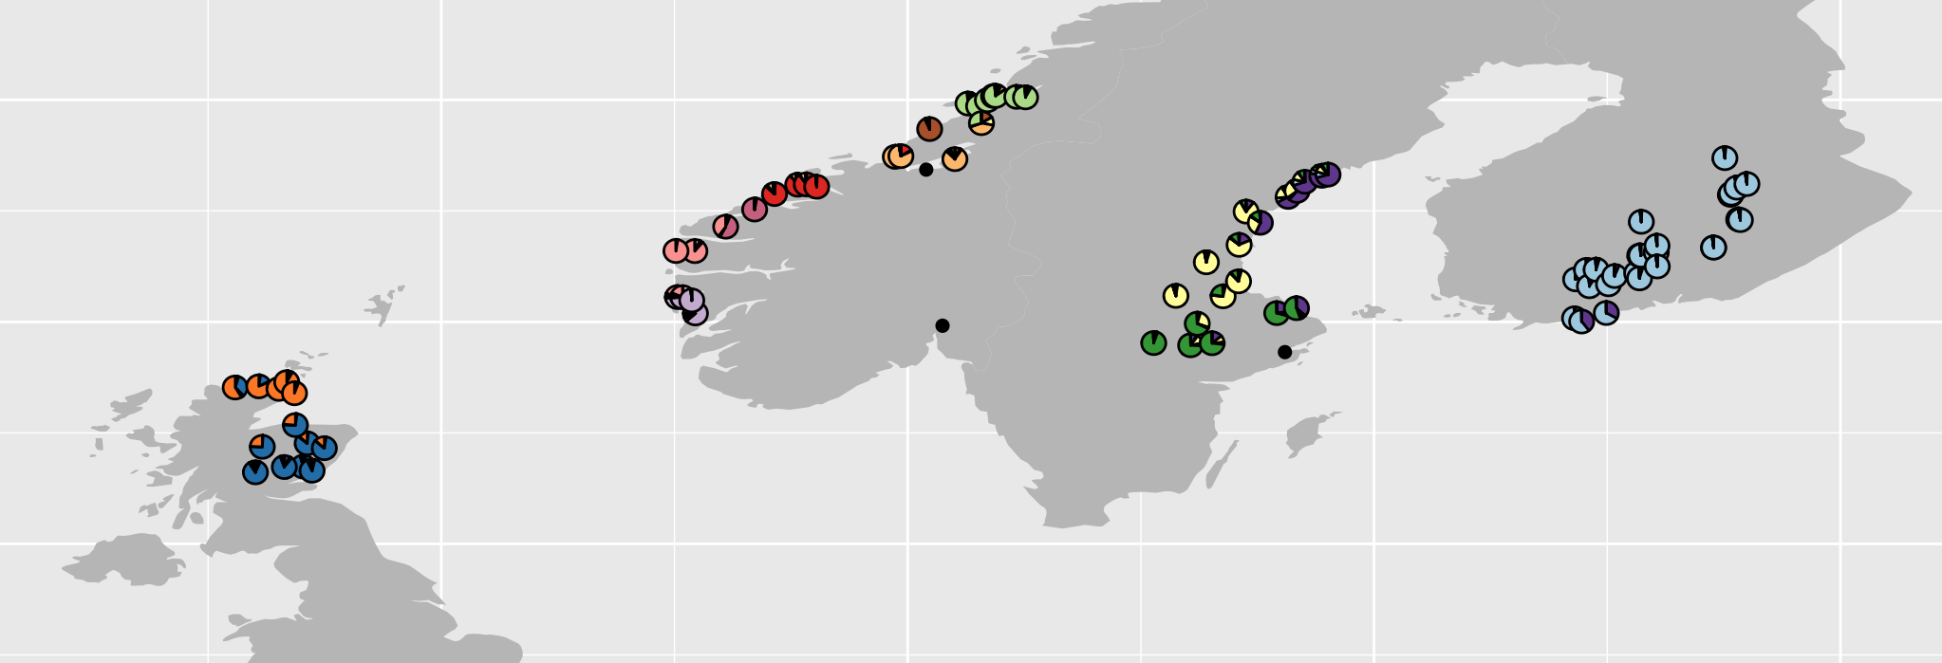
Whole Genome Sequencing data (2022 and 2023)

Slide 4
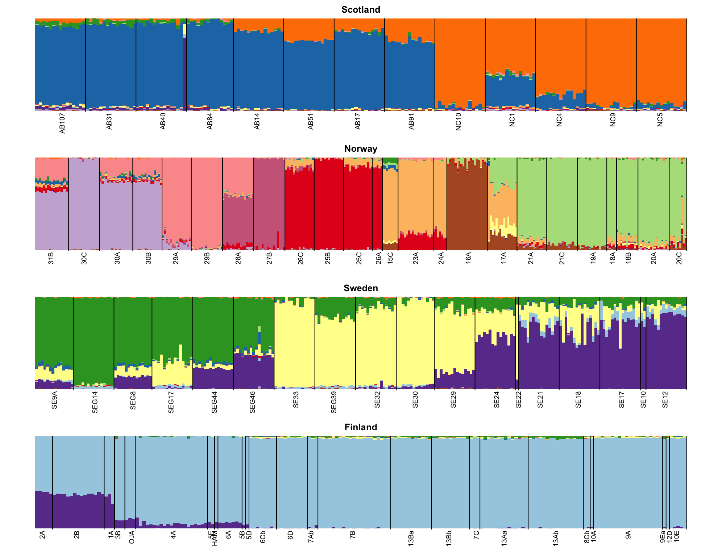
Whole Genome
Sequencing data
(2022 and 2023)
3 million SNPs

Slide 5
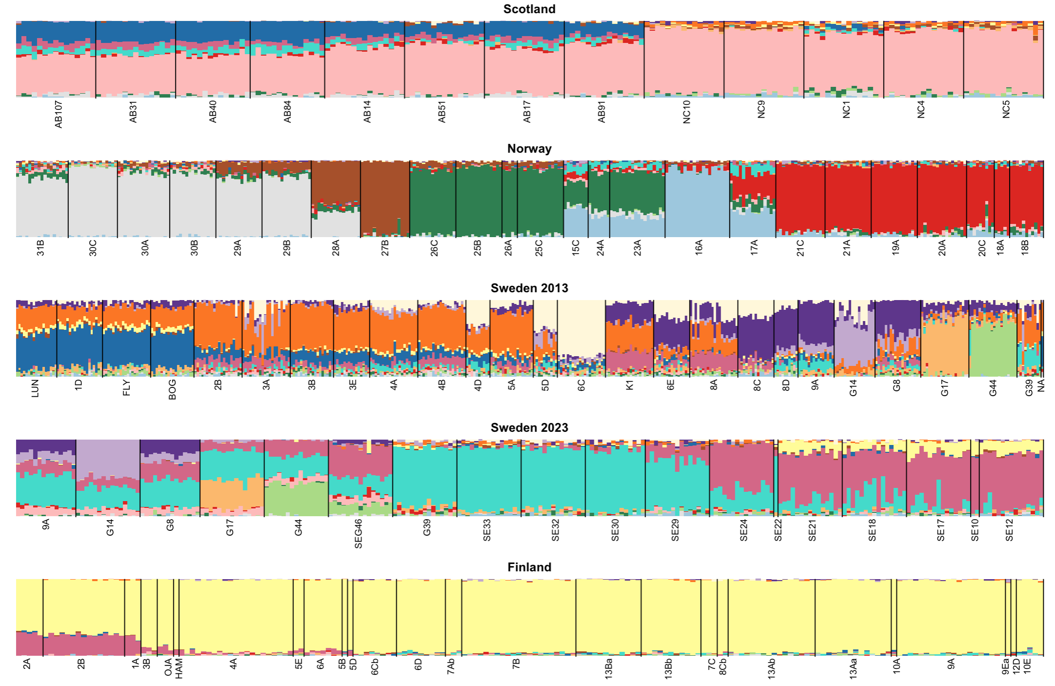
RAD loci only
17k SNPs
Note different colors sorry

Slide 6
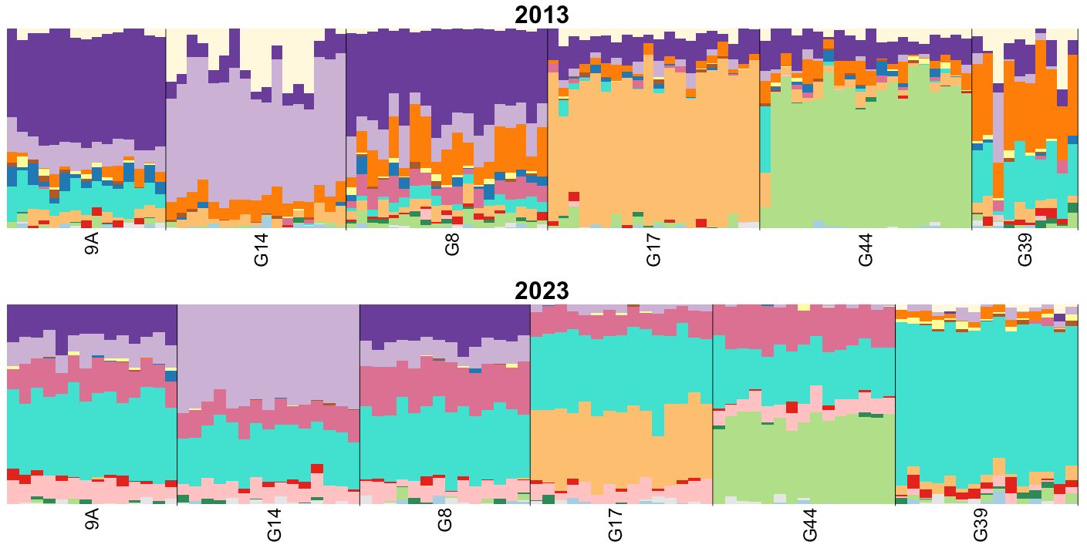
Turnover at resampled Swedish sites

Slide 7
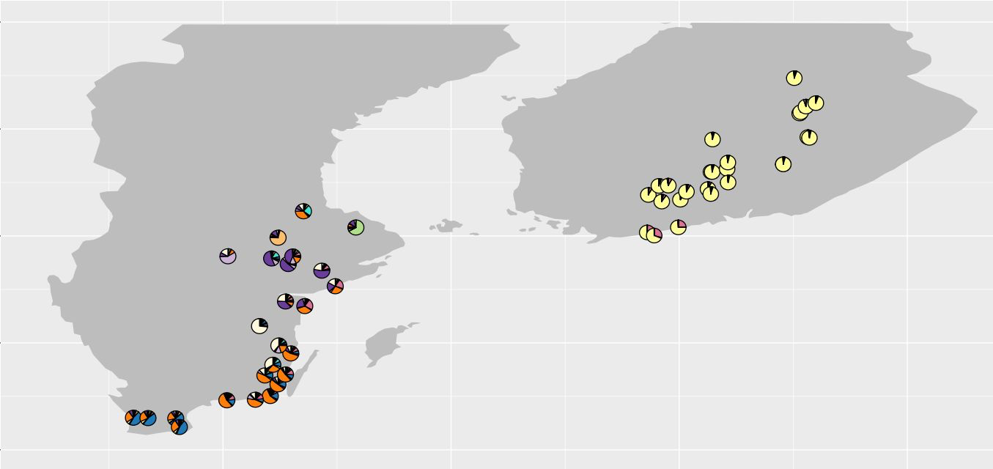
2022
2013

Slide 8
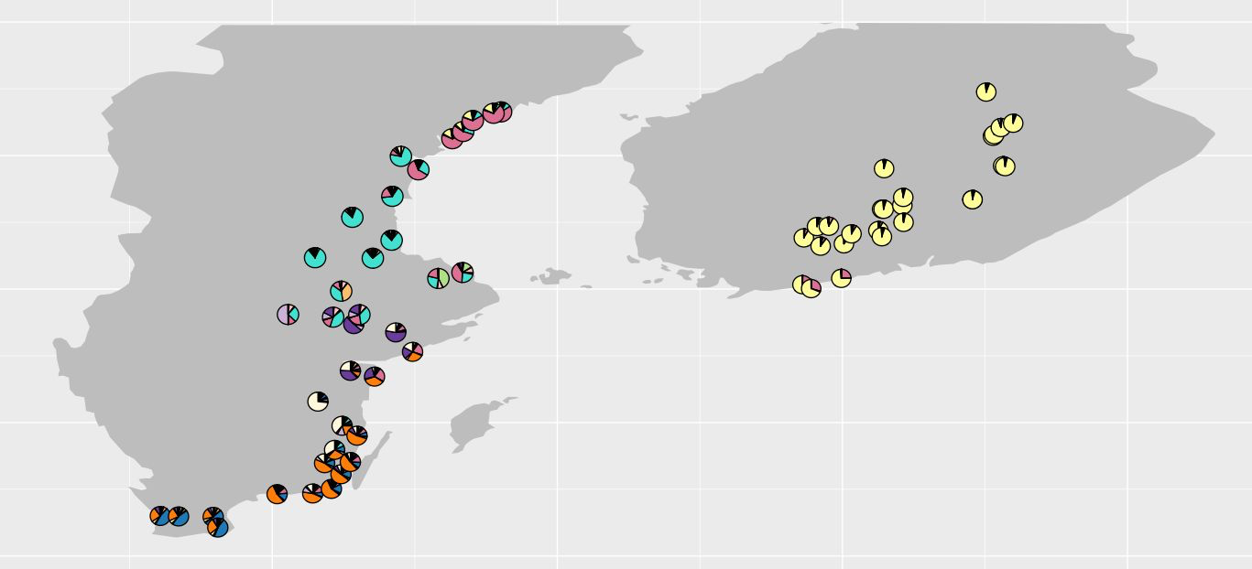
2022
2023
2013

Slide 9
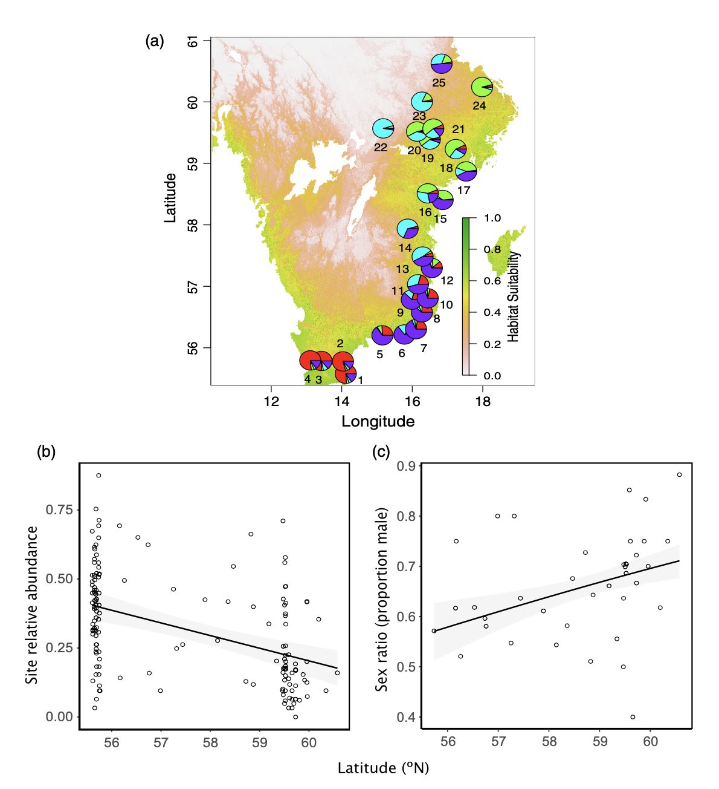
Relative abundance (number of individuals caught per minute of effort) and sex ratio vary with latitude.
https://besjournals.onlinelibrary.wiley.com/doi/epdf/10.1111/1365-2656.13488

Slide 10
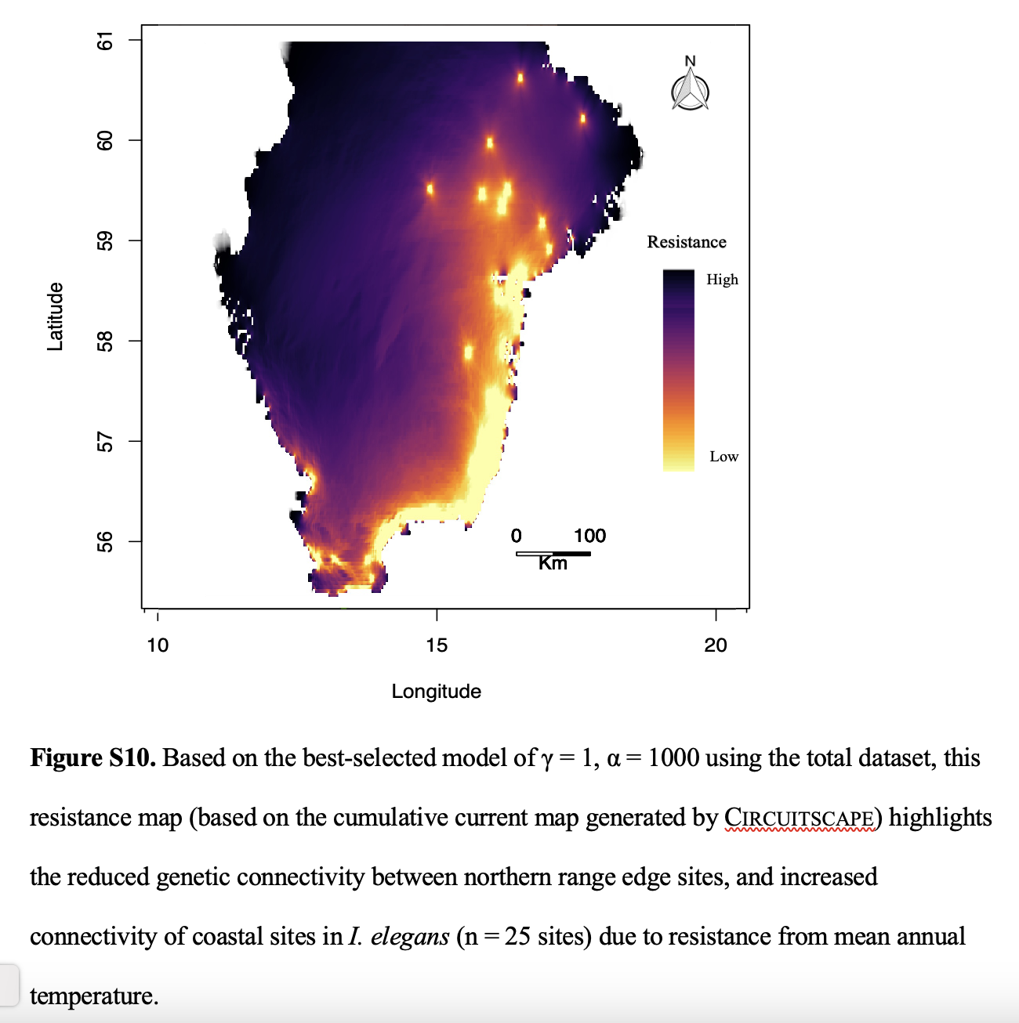
Data and code from Dudaniec et al. 2022 / Rachael Dudaniec

Slide 11
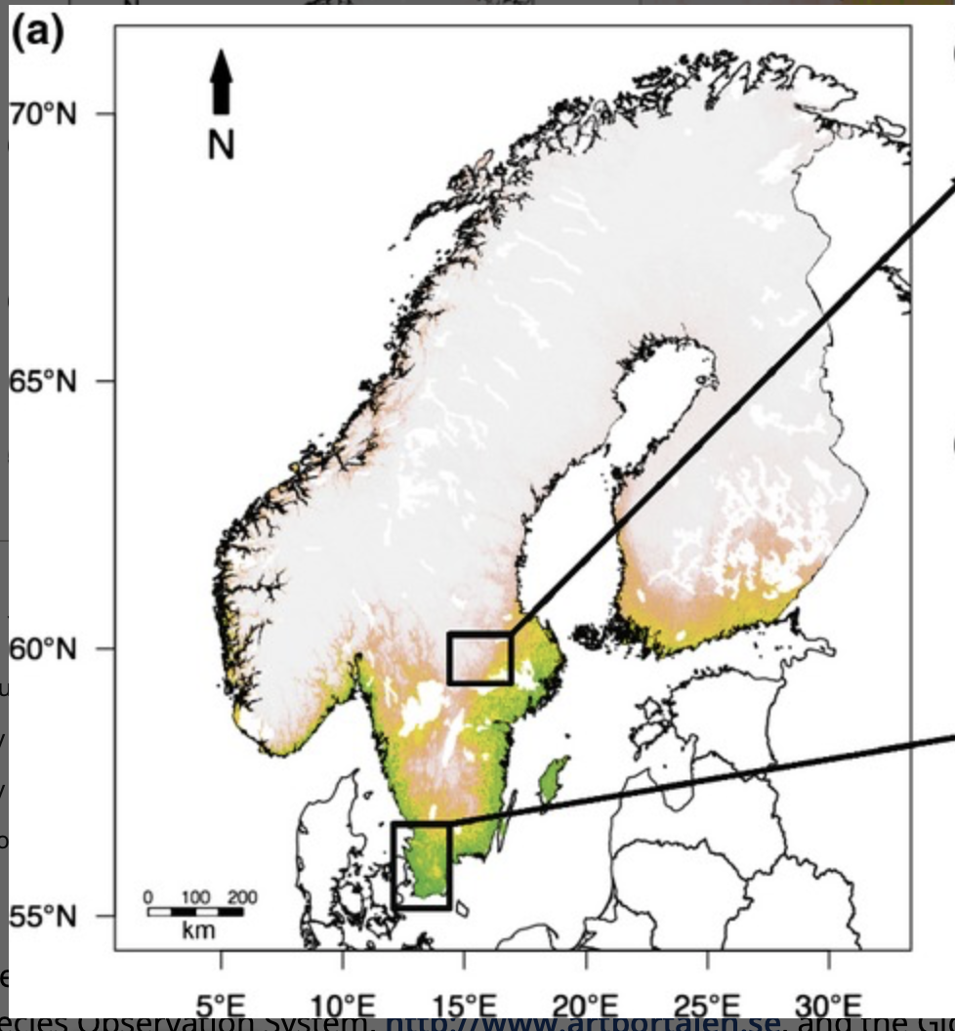
Available SDM layer, based on bioclim data - Lancaster et al 2015
"Our average capture rates in these populations (numbers of individuals caught per minute of catching effort; a proxy for site density) were significantly correlated with predicted habitat suitability values from our species distribution model [effect of habitat suitability on log(capture rate) = 2.03 ± 0.55, t = 3.73, P = 0.001, R2 = 0.37]."

Slide 12
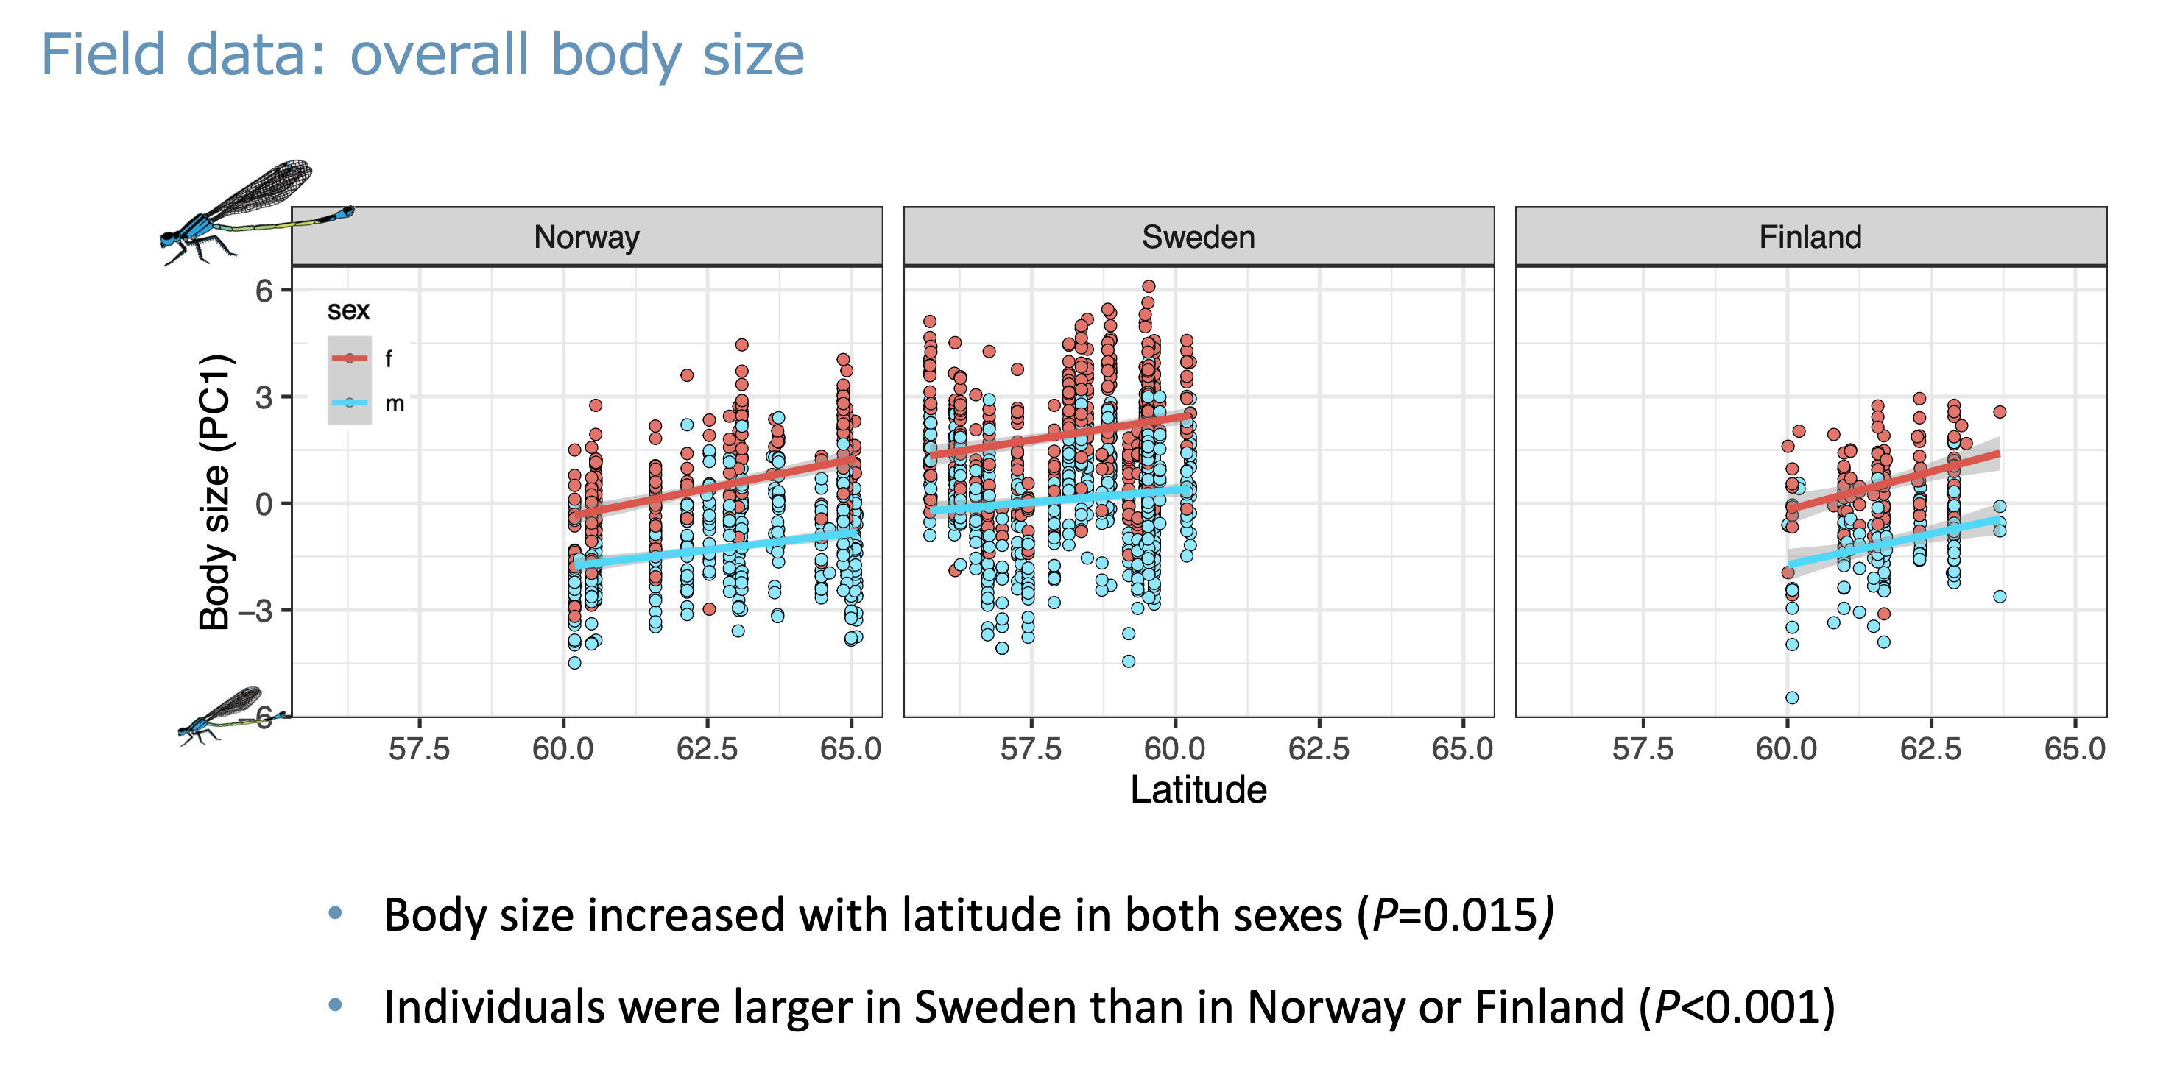

Slide 13
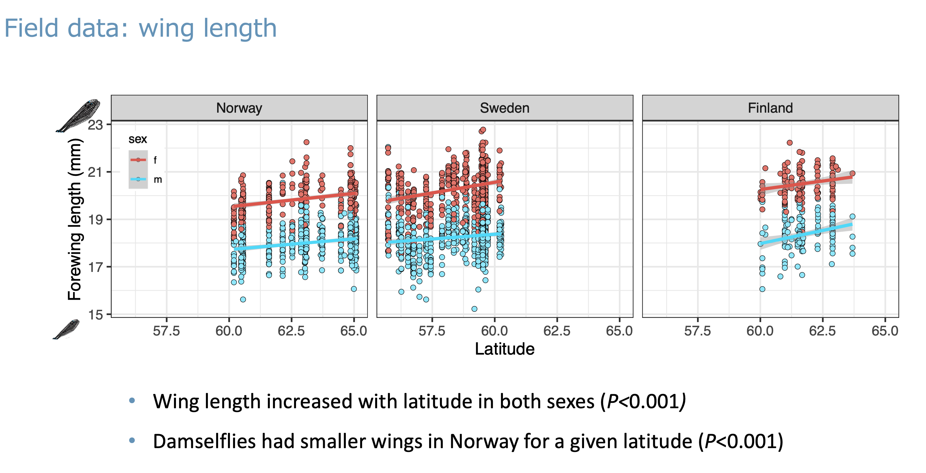

Slide 14
